Slide 1
Chapter 3
Arithmetic for Computers

Slide 2
Arithmetic for Computers
§3.1 Introduction
Operations on integers
  Addition and subtraction
  Multiplication and division
  Dealing with overflow
Floating-point real numbers
  Representation and operations

Slide 3
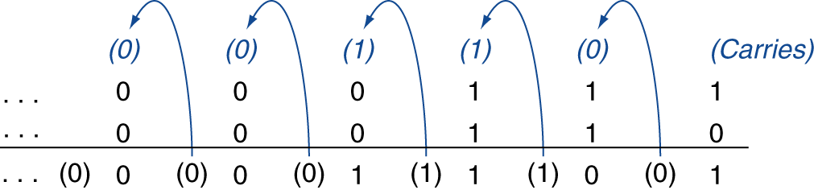
Integer Addition
Example: 7 + 6
§3.2 Addition and Subtraction
Overflow if result out of range
  Adding +ve and –ve operands, no overflow
  Adding two +ve operands
    Overflow if result sign is 1
  Adding two –ve operands
    Overflow if result sign is 0

Slide 4
Integer Subtraction
Add negation of second operand
Example: 7 – 6 = 7 + (–6)
  +7: 0000 0000 … 0000 0111
  –6: 1111 1111 … 1111 1010
  +1: 0000 0000 … 0000 0001
Overflow if result out of range
  Subtracting two +ve or two –ve operands, no overflow
  Subtracting +ve from –ve operand
    Overflow if result sign is 0
  Subtracting –ve from +ve operand
    Overflow if result sign is 1

Slide 5
Dealing with Overflow
Some languages (e.g., C) ignore overflow, other languages (e.g., Ada, Fortran) require raising an exception
Integer arithmetic operations for bytes and halfwords in RISC-V
  Unsigned integers
    Load with lbu, lhu; arithmetic with add, sub, mul, div; then store using sb, sh
  Signed integers
    Load with lb, lh; arithmetic with add, sub, mul, div; then store using sb, sh
Saturating operations

Slide 6
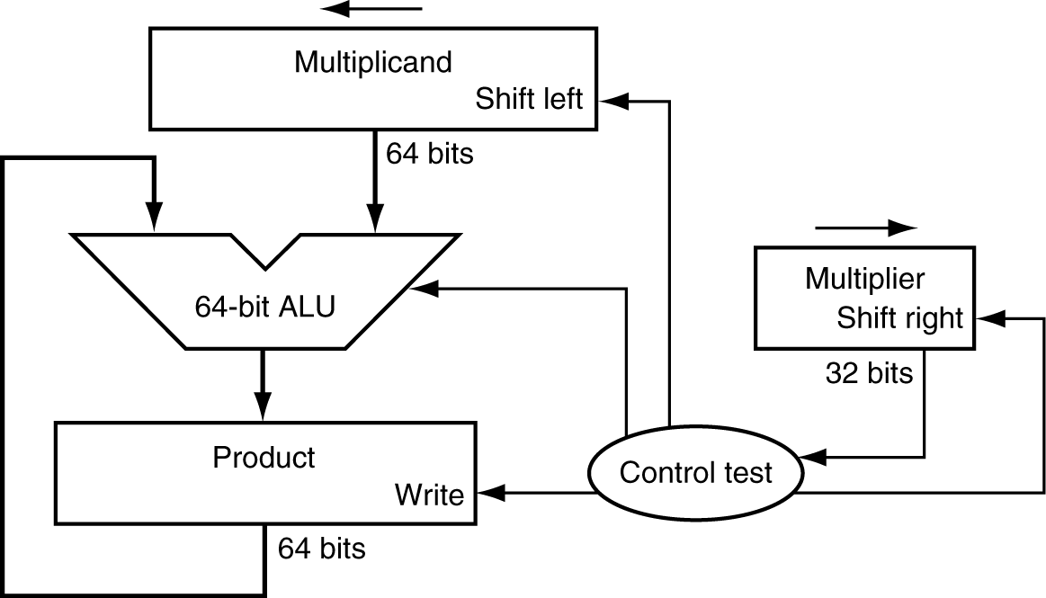
Multiplication
§3.3 Multiplication
Start with long-multiplication approach
multiplicand
1000
× 1001
1000
0000
0000
1000
1001000
multiplier
product
Length of product is the sum of operand lengths

Slide 7
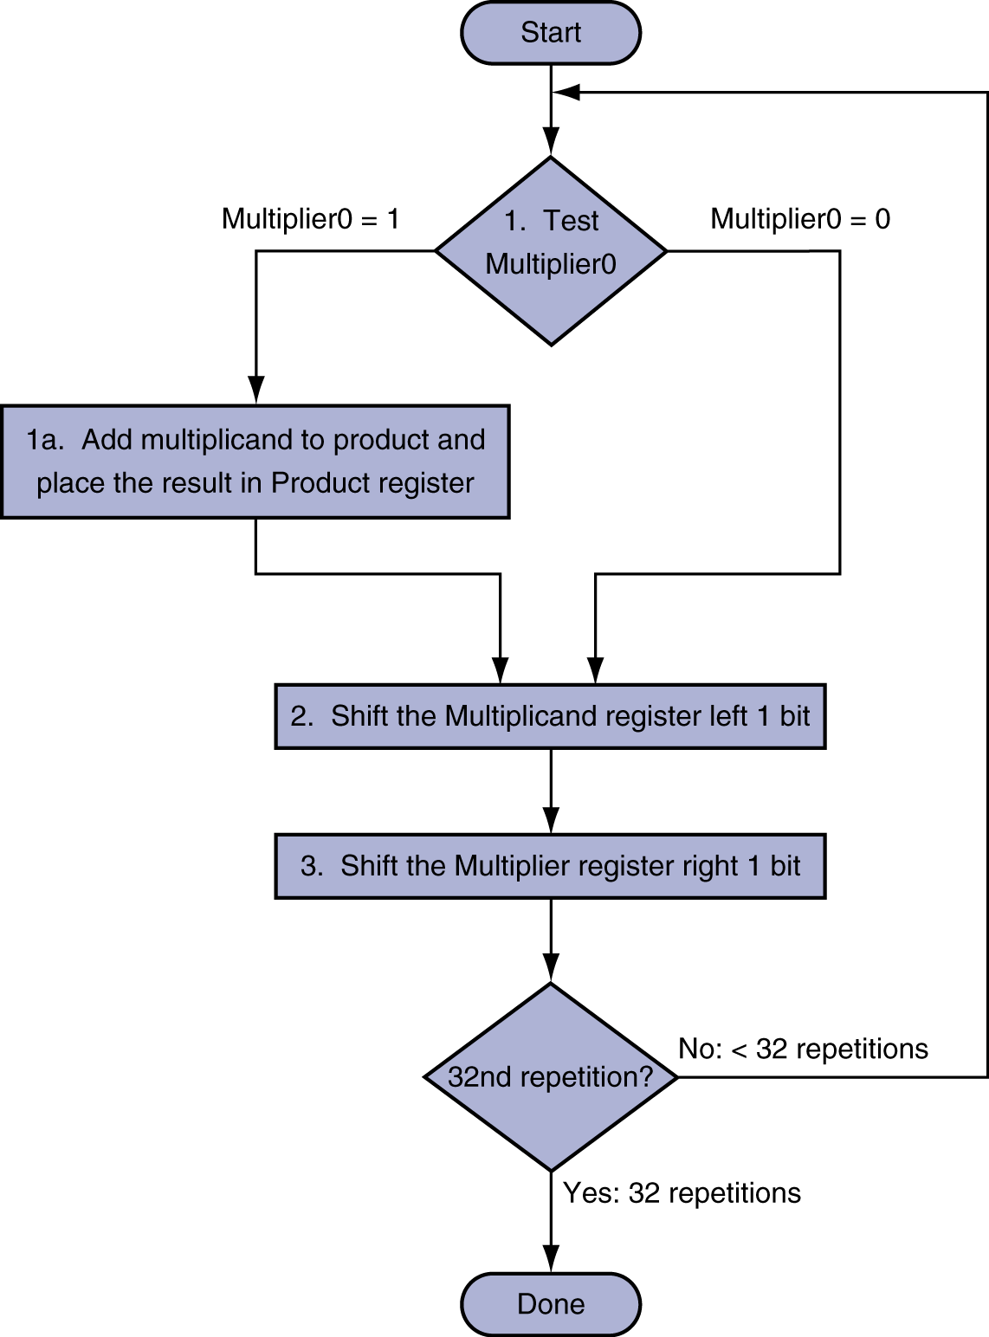
Multiplication Hardware
Initially 0

Slide 8
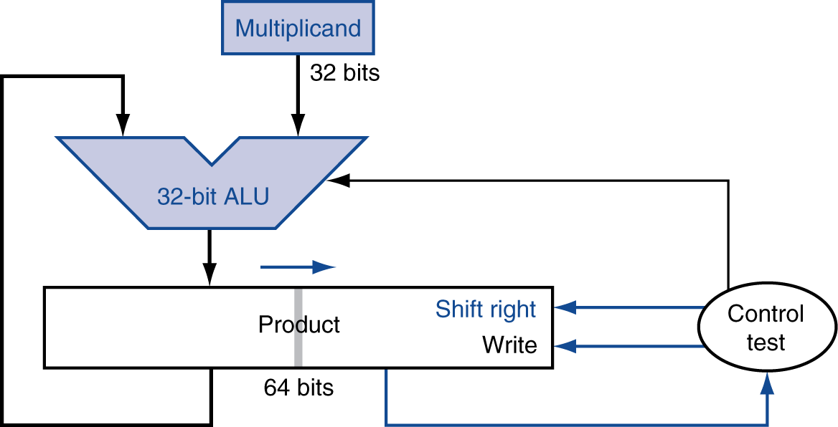
Optimized Multiplier
Perform steps in parallel: add/shift
One cycle per partial-product addition
  That’s ok, if frequency of multiplications is low

Slide 9
Signed Multiplication
Basic approach:
  Store the signs of the operands
  Convert signed numbers to unsigned numbers
  (most significant bit (MSB) = 0)
  Perform multiplication
  If sign bits of operands are equal
  sign bit = 0, else
  sign bit = 1

Slide 10
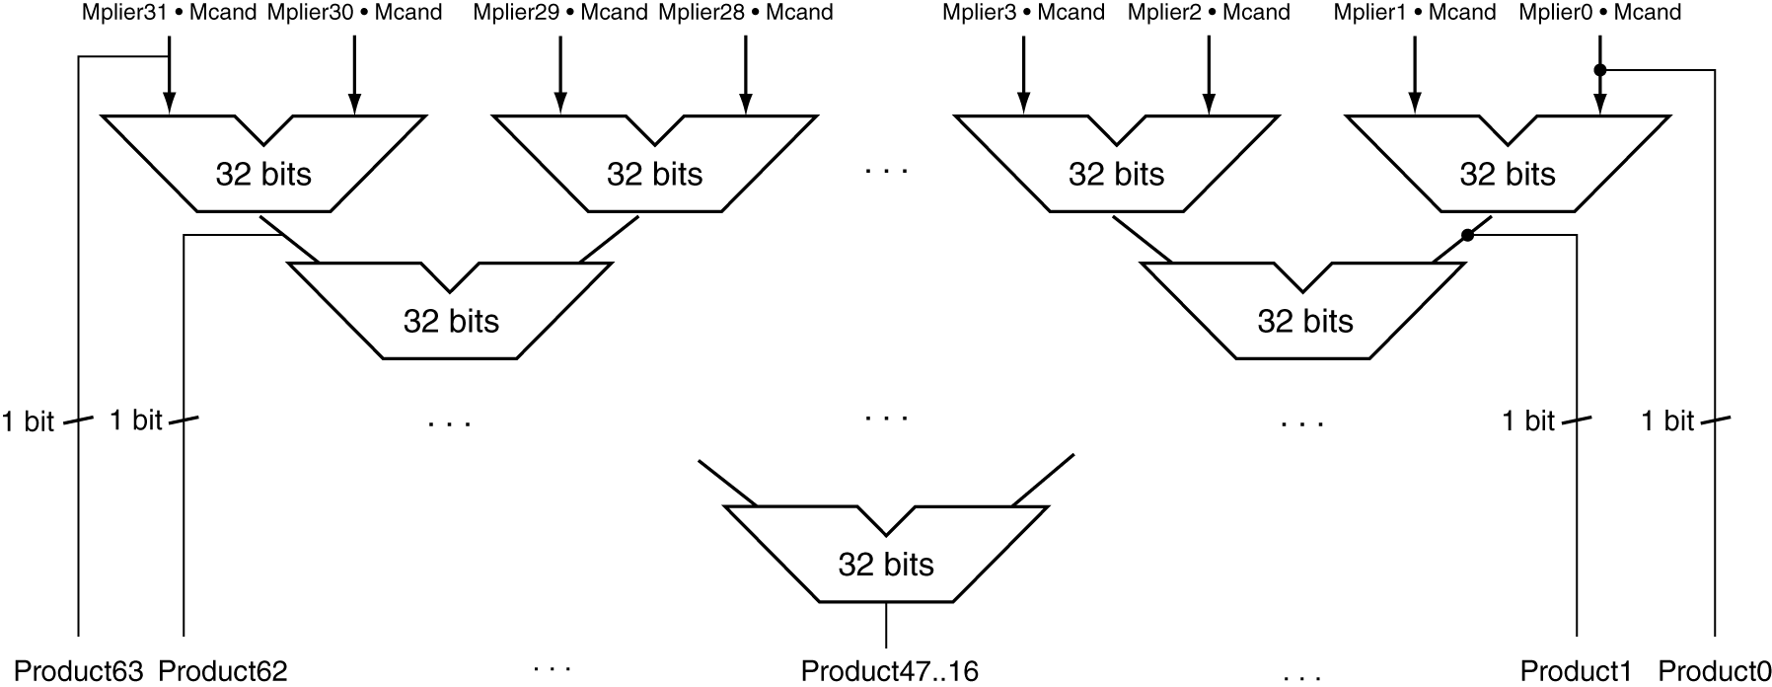
Faster Multiplier
Uses multiple adders
  Cost/performance tradeoff
Can be pipelined
  Several multiplication performed in parallel

Slide 11
Multiply in RISC-V
Category | Instruction | Example | Meaning | Comments
Arithmetic | Multiply | mul x5,x6,x7 | x5=x6 * x7 | Lower 32 bits of 64-bit product
 | Multiply high | mulh x5,x6,x7 | x5=(x6 * x7) >> 32 | Upper 32 bits of 64-bit signed product
 | Multiply high, unsigned | mulhu x5,x6,x7 | x5=(x6 * x7) >> 32 | Upper 32 bits of 64-bit unsigned product
 | Multiply high, signed-unsigned | mulhsu x5,x6,x7 | x5=(x6 * x7) >> 32 | Upper 32 bits of 64-bit signed-unsigned product

Slide 12
Division
§3.4 Division
Check for 0 divisor
Long division approach
  If divisor ≤ dividend bits
    1 bit in quotient, subtract
  Otherwise
    0 bit in quotient, bring down next dividend bit
Restoring division
  Do the subtract, and if remainder goes < 0, add divisor back
Signed division
  Divide using absolute values
  Adjust sign of quotient and remainder as required
quotient
dividend
1001
1000 1001010
-1000
10
101
1010
-1000
10
divisor
remainder
n-bit operands yield n-bit
quotient and remainder

Slide 13
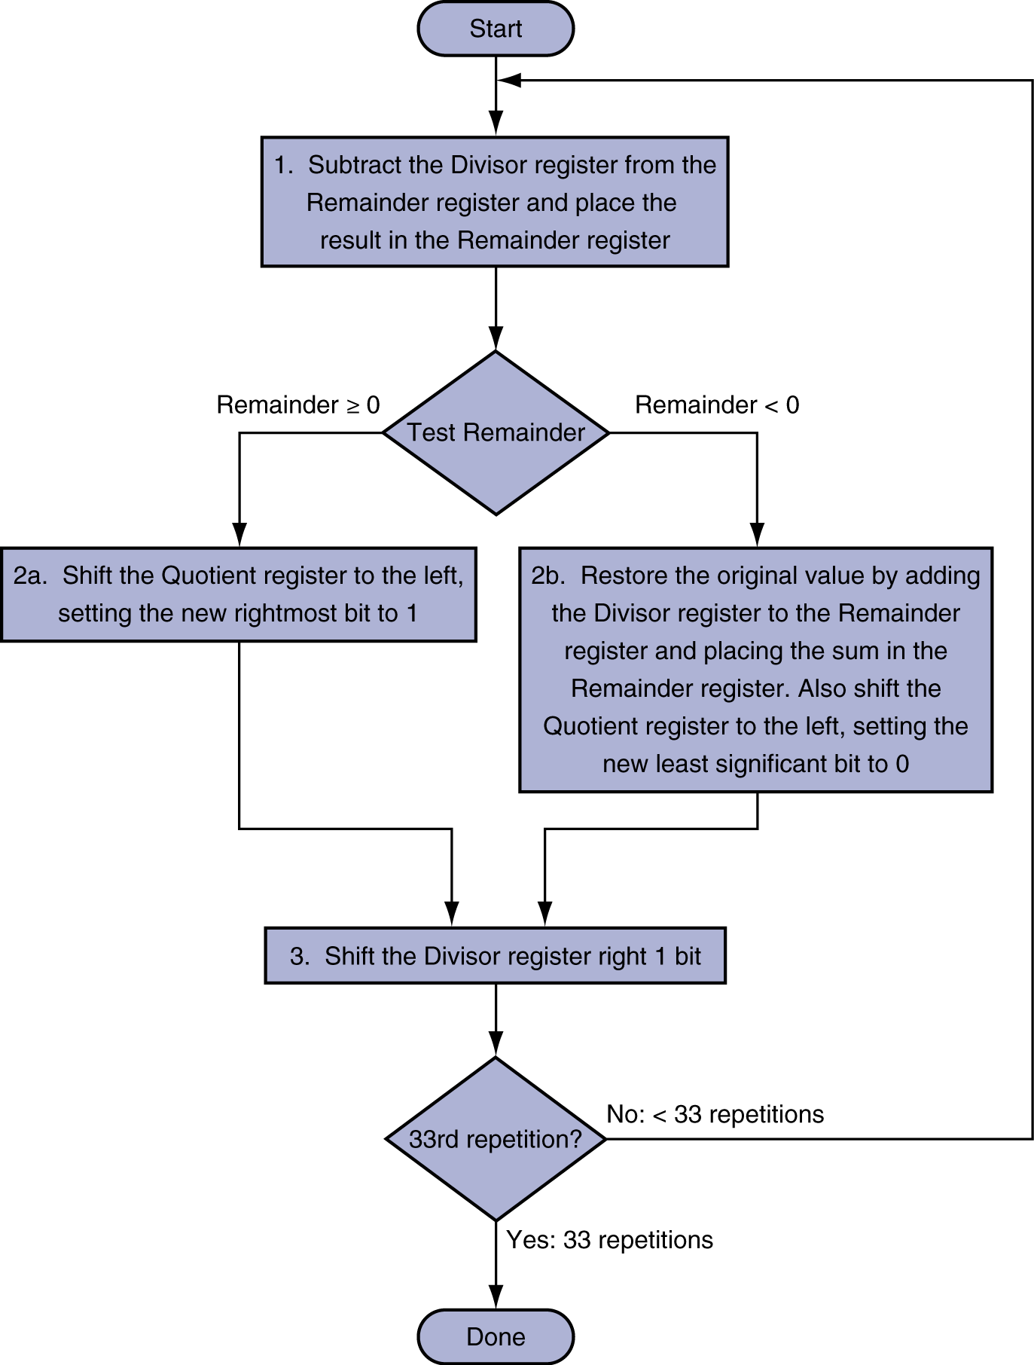
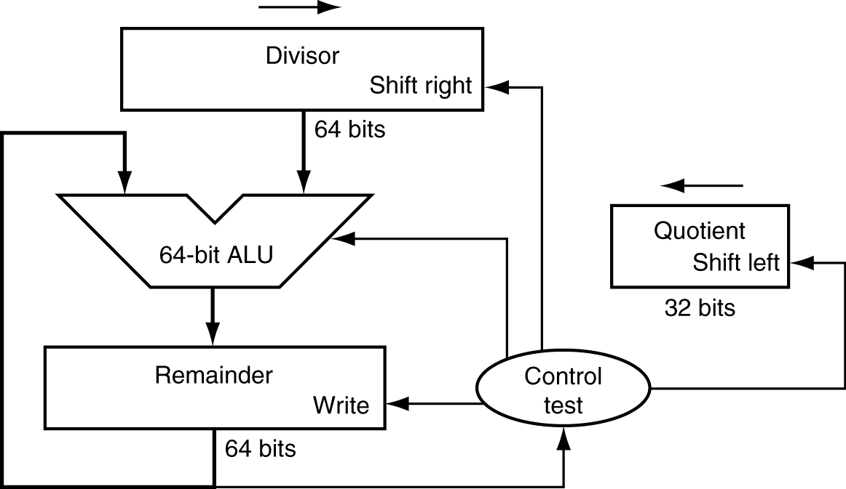
Division Hardware
Initially divisor in left half
Initially dividend

Slide 14
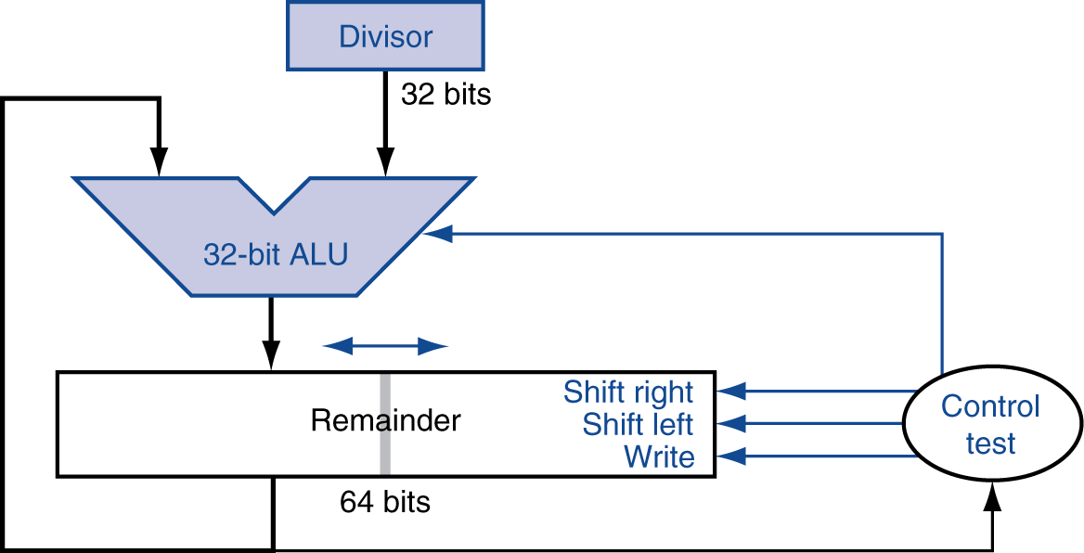
Optimized Divider
One cycle per partial-remainder subtraction
Looks a lot like a multiplier!
  Same hardware can be used for both

Slide 15
Signed Division
The sign of quotient in Division is similar to that in Multiplication
The remainder and the dividend must have identical signs
  (+7) ÷ (+2) = + 3 Remainder = +1
    7 = 3 × 2 + (+1) = 6 + 1
  (-7) ÷ (+2) = - 3 Remainder = -1
    -7 = -3 × 2 + (-1) = - 6 - 1
  (+7) ÷ (- 2) = - 3 Remainder = +1
  (-7) ÷ (- 2) = + 3 Remainder = -1
  avoid : (+7) ÷ (- 2) = - 4 Remainder = -1

Slide 16
Faster Division
Can’t use parallel hardware as in multiplier
  Subtraction is conditional on sign of remainder
Faster dividers (e.g. SRT devision) generate multiple quotient bits per step
  Still require multiple steps

Slide 17
Divide in RISC-V
Category | Instruction | Example | Meaning | Comments
Arithmetic | Divide | div x5,x6,x7 | x5=x6 / x7 | Divide signed 32-bit numbers
 | Divide unsigned | divu x5,x6,x7 | x5=x6 / x7 | Divide unsigned 32-bit numbers
 | Remainder | rem x5,x6,x7 | x5=x6 % x7 | Remainder of signed 32-bit division
 | Remainder unsigned | remu x5,x6,x7 | x5=x6 % x7 | Remainder of unsigned 32-bit division

Slide 18
Floating Point
§3.5 Floating Point
Representation for non-integral numbers
  Including very small and very large numbers
Like scientific notation
  –2.34 × 10⁵⁶
  +0.002 × 10^{–4}
  +987.02 × 10⁹
In binary
  ±1.xxxxxxx₂ × 2^{yyyy}
Types float and double in C
normalized
not normalized

Slide 19
Floating Point Standard
Defined by IEEE Std 754-1985
Developed in response to divergence of representations
  Portability issues for scientific code
Now almost universally adopted
Two representations
  Single precision (32-bit)
  Double precision (64-bit)

Slide 20
IEEE Floating-Point Format
single: 8 bits
double: 11 bits
single: 23 bits
double: 52 bits
S
Exponent
Fraction
S: sign bit (0 ⇒ non-negative, 1 ⇒ negative)
Normalize significand: 1.0 ≤ |significand| < 2.0
  Always has a leading pre-binary-point 1 bit, so no need to represent it explicitly (hidden bit)
  Significand is Fraction with the “1.” restored
Exponent: excess representation: actual exponent + Bias
  Ensures exponent is unsigned
  Single: Bias = 127; Double: Bias = 1203

Slide 21
Single-Precision Range
Exponents 00000000 and 11111111 reserved
Smallest value
  Exponent: 00000001
  ⇒ actual exponent = 1 – 127 = –126
  Fraction: 000…00 ⇒ significand = 1.0
  ±1.0 × 2^{–126} ≈ ±1.2 × 10^{–38}
Largest value
  exponent: 11111110
  ⇒ actual exponent = 254 – 127 = +127
  Fraction: 111…11 ⇒ significand ≈ 2.0
  ±2.0 × 2⁺¹²⁷ ≈ ±3.4 × 10⁺³⁸

Slide 22
Double-Precision Range
Exponents 0000…00 and 1111…11 reserved
Smallest value
  Exponent: 00000000001
  ⇒ actual exponent = 1 – 1023 = –1022
  Fraction: 000…00 ⇒ significand = 1.0
  ±1.0 × 2^{–1022} ≈ ±2.2 × 10^{–308}
Largest value
  Exponent: 11111111110
  ⇒ actual exponent = 2046 – 1023 = +1023
  Fraction: 111…11 ⇒ significand ≈ 2.0
  ±2.0 × 2⁺¹⁰²³ ≈ ±1.8 × 10⁺³⁰⁸

Slide 23
Floating-Point Precision
Relative precision
  all fraction bits are significant
  Single: approx 2^{–23}
    Equivalent to 23 × log₁₀2 ≈ 23 × 0.3 ≈ 6 decimal digits of precision
  Double: approx 2^{–52}
    Equivalent to 52 × log₁₀2 ≈ 52 × 0.3 ≈ 16 decimal digits of precision

Slide 24
Floating-Point Example
Represent –0.75
  –0.75 = (–1)¹ × 1.1₂ × 2^{–1}
  S = 1
  Fraction = 1000…00₂
  Exponent = –1 + Bias
    Single: –1 + 127 = 126 = 01111110₂
    Double: –1 + 1023 = 1022 = 01111111110₂
Single: 1011111101000…00
Double: 1011111111101000…00

Slide 25
Floating-Point Example
What number is represented by the single-precision float
11000000101000…00
  S = 1
  Fraction = 01000…00₂
  Fxponent = 10000001₂ = 129
x = (–1)¹ × (1 + 01₂) × 2^{(129 – 127)}
  = (–1) × 1.25 × 2²
  = –5.0

Slide 26
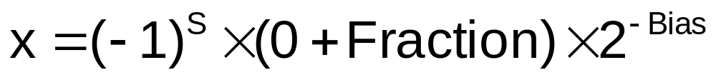
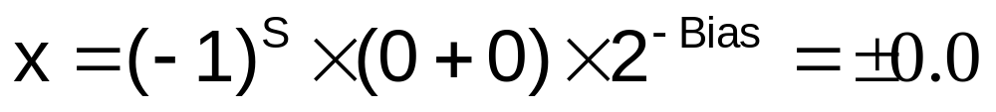
Denormal Numbers
Exponent = 000...0 ⇒ hidden bit is 0
Smaller than normal numbers
  allow for gradual underflow, with diminishing precision
Denormal with fraction = 000...0
Two representations of 0.0!

Slide 27
Infinities and NaNs
Exponent = 111...1, Fraction = 000...0
  ±Infinity
  Can be used in subsequent calculations, avoiding need for overflow check
Exponent = 111...1, Fraction ≠ 000...0
  Not-a-Number (NaN)
  Indicates illegal or undefined result
    e.g., 0.0 / 0.0
  Can be used in subsequent calculations

Slide 28
Floating-Point Addition
Consider a 4-digit decimal example
  9.999 × 10¹ + 1.610 × 10^{–1}
1. Align decimal points
  Shift number with smaller exponent
  9.999 × 10¹ + 0.016 × 10¹
2. Add significands
  9.999 × 10¹ + 0.016 × 10¹ = 10.015 × 10¹
3. Normalize result & check for over/underflow
  1.0015 × 10²
4. Round and renormalize if necessary
  1.002 × 10²

Slide 29
Floating-Point Addition
Now consider a 4-digit binary example
  1.000₂ × 2^{–1} + –1.110₂ × 2^{–2} (0.5 + –0.4375)
1. Align binary points
  Shift number with smaller exponent
  1.000₂ × 2^{–1} + –0.111₂ × 2^{–1}
2. Add significands
  1.000₂ × 2^{–1} + –0.111₂ × 2–1 = 0.001₂ × 2^{–1}
3. Normalize result & check for over/underflow
  1.000₂ × 2^{–4}, with no over/underflow
4. Round and renormalize if necessary
  1.000₂ × 2^{–4} (no change) = 0.0625

Slide 30
FP Adder Hardware
Much more complex than integer adder
Doing it in one clock cycle would take too long
  Much longer than integer operations
  Slower clock would penalize all instructions
FP adder usually takes several cycles
  Can be pipelined

Slide 31
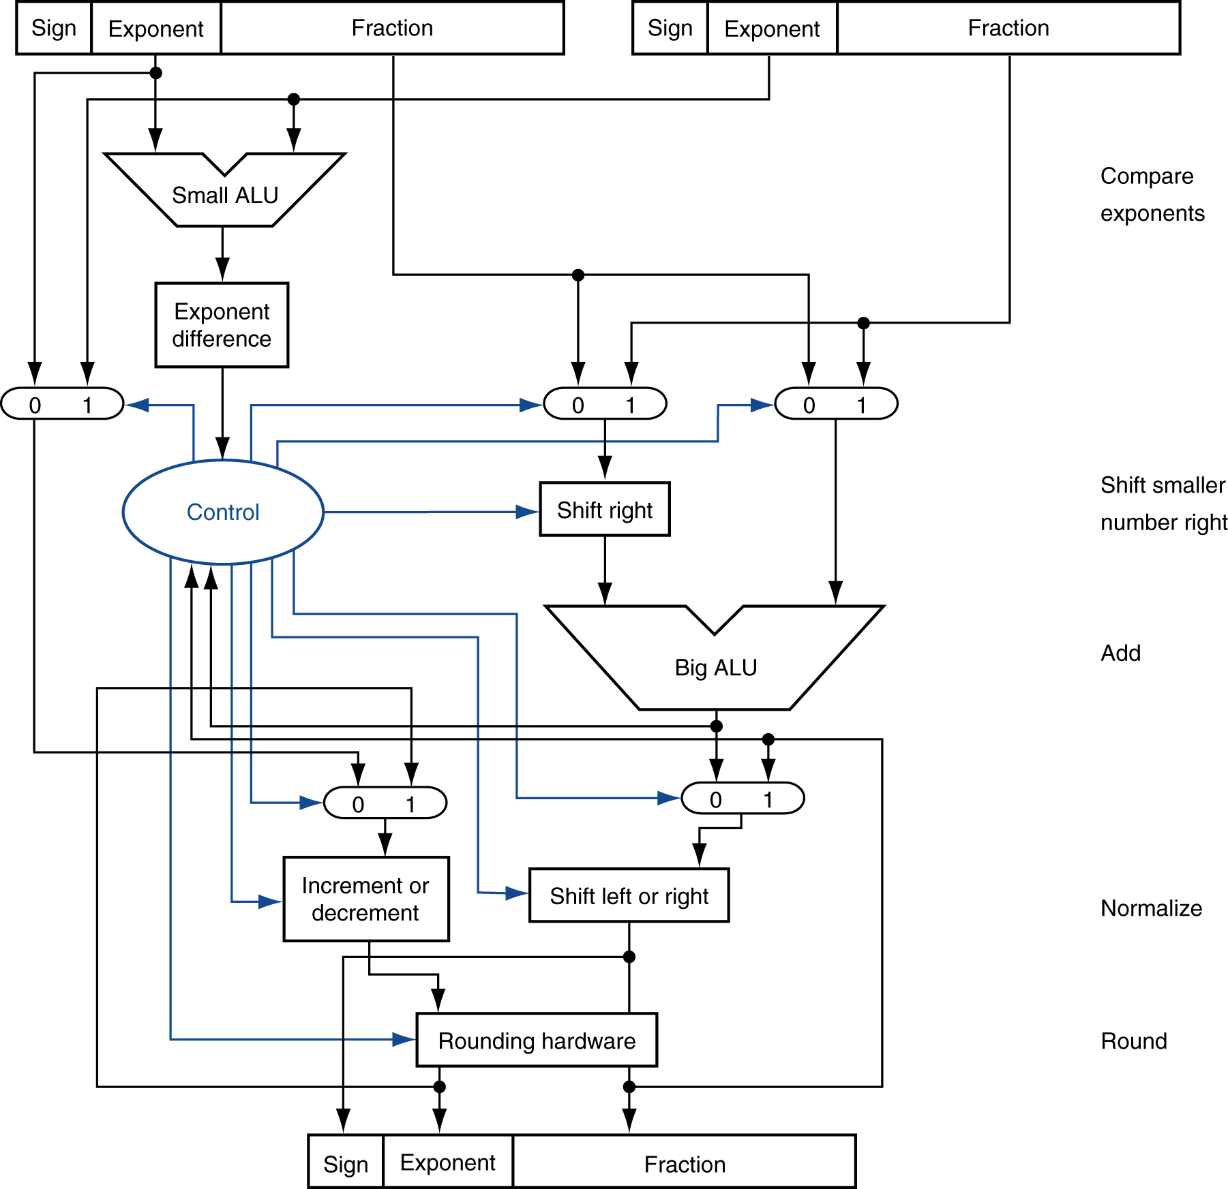
FP Adder Hardware
Step 1
Step 2
Step 3
Step 4

Slide 32
Floating-Point Multiplication
Consider a 4-digit decimal example
  1.110 × 10¹⁰ × 9.200 × 10^{–5}
1. Add exponents
  For biased exponents, subtract bias from sum
  New exponent = 10 + –5 = 5
2. Multiply significands
  1.110 × 9.200 = 10.212 ⇒ 10.212 × 10⁵
3. Normalize result & check for over/underflow
  1.0212 × 10⁶
4. Round and renormalize if necessary
  1.021 × 10⁶
5. Determine sign of result from signs of operands
  +1.021 × 10⁶

Slide 33
Floating-Point Multiplication
Now consider a 4-digit binary example
  1.000₂ × 2^{–1} × –1.110₂ × 2^{–2} (0.5 × –0.4375)
1. Add exponents
  Unbiased: –1 + –2 = –3
  Biased: (–1 + 127) + (–2 + 127) = –3 + 254 – 127 = –3 + 127
2. Multiply significands
  1.000₂ × 1.110₂ = 1.1102 ⇒ 1.110₂ × 2^{–3}
3. Normalize result & check for over/underflow
  1.110₂ × 2^{–3} (no change) with no over/underflow
4. Round and renormalize if necessary
  1.110₂ × 2^{–3} (no change)
5. Determine sign: +ve × –ve ⇒ –ve
  –1.110₂ × 2^{–3} = –0.21875

Slide 34
FP Arithmetic Hardware
FP multiplier is of similar complexity to FP adder
  But uses a multiplier for significands instead of an adder
FP arithmetic hardware usually does
  Addition, subtraction, multiplication, division, reciprocal, square-root
  FP ↔ integer conversion
Operations usually takes several cycles
  Can be pipelined

Slide 35
FP Instructions in RISC-V
Separate FP registers
  32 double-precision: f0, f1, … f31
  A single precision register is just the lower half of a double-precision register
  Unlike integer register x0, floating-point register f0 is not hard-wired to the constant 0
FP instructions operate only on FP registers
  Programs generally don’t do integer ops on FP data, or vice versa
  More registers with minimal code-size impact
FP load and store instructions
  Double-precision: fld, fsd
  Single-precision: flw, fsw

Slide 36
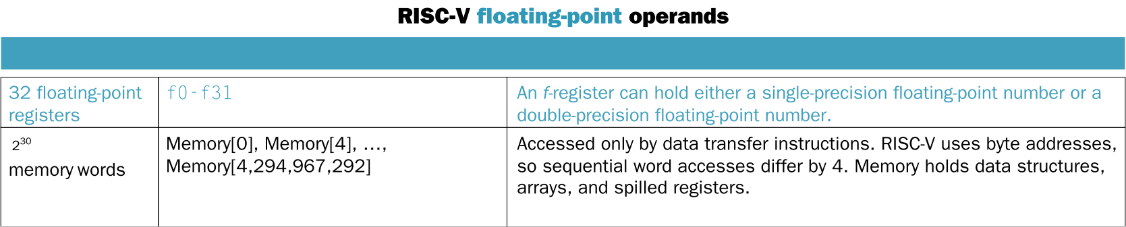
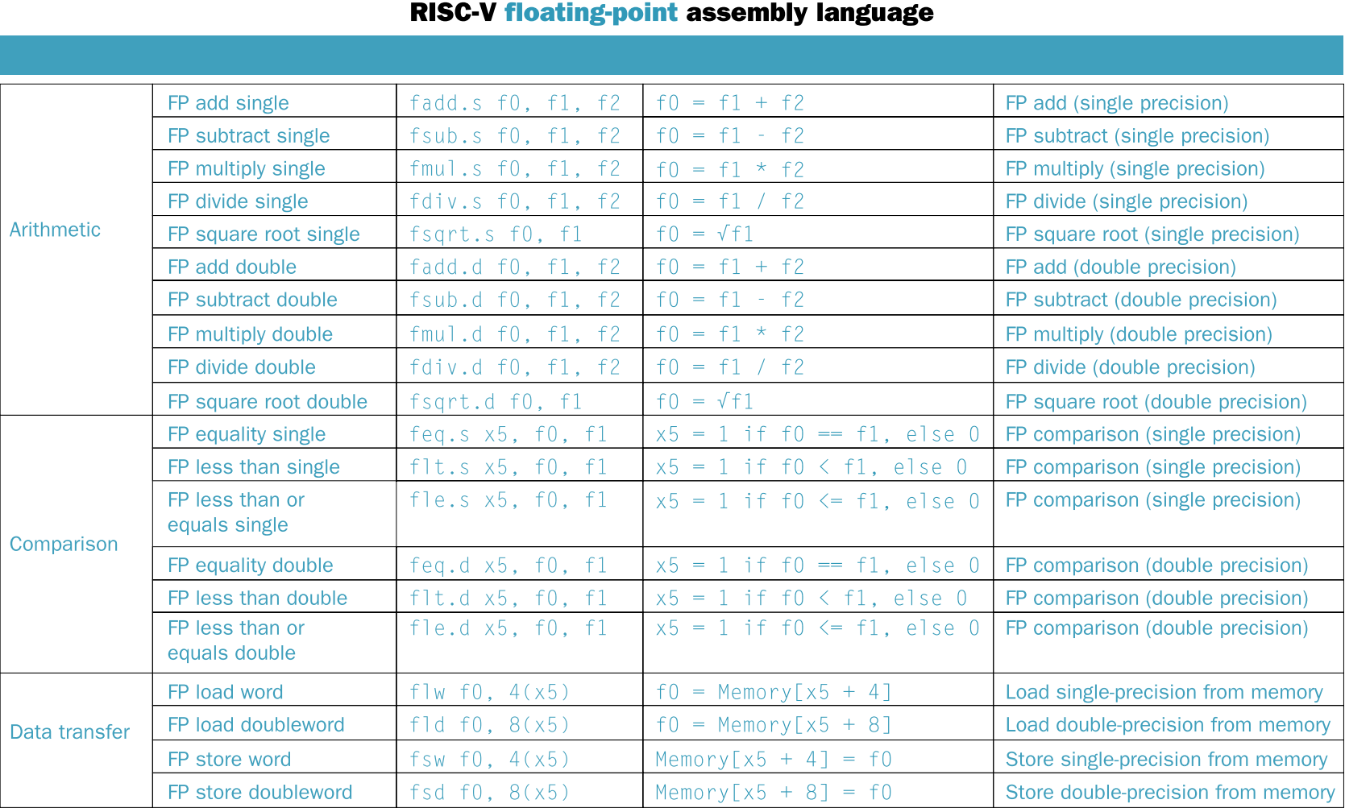
FP Instructions in RISC-V

Slide 37
FP Example: °F to °C
C code:
float f2c (float fahr) {
return ((5.0f / 9.0f)*(fahr - 32.0f));
}
  fahr in f10, result in f10, constants in memory within easy reach of register x3
Compiled RISC-V code:
f2c: flw f0, const5(x3) // f0 = 5.0f
flw f1, const9(x3) // f1 = 9.0f
fdiv.s f0, f0, f1 // f0 = 5.0f / 9.0f
flw f1, const32(x3) // f1 = 32.0f
fsub.s f10, f10, f1 // f10 = fahr – 32.0f
fmul.s f10, f0, f10 // f10 = (5.0f / 9.0f)*(fahr – 32.0f)
jalr x0, 0(x1) // return

Slide 38
FP Example: Array Multiplication
C = C + A × B
  All 32 × 32 matrices, 64-bit double-precision elements
C code:
void mm (double c[][], double a[][], double b[][])
{
size_t i, j, k;
for (i = 0; i < 32; i = i + 1)
for (j = 0; j < 32; j = j + 1)
for (k = 0; k < 32; k = k + 1)
c[i][j] = c[i][j] + a[i][k] * b[k][j];
}
  Addresses of c, a, b in x10, x11, x12, and
  i, j, k in x5, x6, x7

Slide 39
FP Example: Array Multiplication
RISC-V code:
mm: addi x28, x0, 32 // x28 = 32 (row size/loop end)
addi x5, x0, 0 // i = 0; initialize 1st for loop
L1: addi x6, x0, 0 // j = 0; initialize 2nd for loop
L2: addi x7, x0, 0 // k = 0; initialize 3rd for loop
slli x30, x5, 5 // x30 = i * 32(size of row of c)
add x30, x30, x6 // x30 = i * size(row) + j
slli x30, x30, 3 // x30 = byte offset of [i][j]
add x30, x10, x30 // x30 = byte address of c[i][j]
fld f0, 0(x30) // f0 = 8 bytes of c[i][j]
L3: slli x29, x7, 5 // x29 = k * 32(size of row of b)
add x29, x29, x6 // x29 = k * size(row) + j
slli x29, x29, 3 // x29 = byte offset of [k][j]
add x29, x12, x29 // x29 = byte address of b[k][j]
fld f1, 0(x29) // f1 = 8 bytes of b[k][j]
…

Slide 40
FP Example: Array Multiplication
…
slli x29, x5, 5 // x29 = i * 32(size of row of a)
add x29, x29, x7 // x29 = i * size(row) + k
slli x29, x29, 3 // x29 = byte offset of [i][k]
add x29, x11, x29 // x29 = byte address of a[i][k]
fld f2, 0(x29) // f2 = a[i][k]
fmul.d f1, f2, f1 // f1 = a[i][k] * b[k][j]
fadd.d f0, f0, f1 // f0 = c[i][j] + a[i][k] * b[k][j]
addi x7, x7, 1 // k = k + 1
bltu x7, x28, L3 // if (k < 32) go to L3
fsd f0, 0(x30) // c[i][j] = f0
addi x6, x6, 1 // j = j + 1
bltu x6, x28, L2 // if (j < 32) go to L2
addi x5, x5, 1 // i = i + 1
bltu x5, x28, L1 // if (i < 32) go to L1

Slide 41
Accurate Arithmetic
IEEE Std 754 specifies additional rounding control
  Extra bits of precision (guard, round, sticky)
  Choice of rounding modes
  Allows programmer to fine-tune numerical behavior of a computation
Not all FP units implement all options
  Most programming languages and FP libraries just use defaults
Trade-off between hardware complexity, performance, and market requirements

Slide 42
Interpretation of Data
The BIG Picture
Bits have no inherent meaning
  Interpretation depends on the instructions applied
Computer representations of numbers
  Finite range and precision
  Need to account for this in programs

Slide 43
Subword Parallelism
Graphics and media processing operates on vectors of 8-bit and 16-bit data
  Use 128-bit adder, with partitioned carry chain
    Operate on 16×8-bit, 8×16-bit, 4×32-bit or 2×64-bit operands
  SIMD (single-instruction, multiple-data)
Data Level Parallelism
x86 FP Architecture
  MMX ⇒ SSE ⇒ SSE2 ⇒ AVX ⇒ AVX512
§3.6 Parallelism and Computer Arithmetic: Subword Parallelism

Slide 44
Fallacy:Right Shift and Division
Left shift by i places multiplies an integer by 2^{i}
Right shift divides by 2^{i}?
  Only for unsigned integers
For signed integers
  Arithmetic right shift: replicate the sign bit
  e.g., –5 / 4
    11111011₂ >> 2 = 11111110₂ = –2
  Logical right shift: this result is clearly wrong
    11111011₂ >> 2 = 00111110₂ = +62
§3.9 Fallacies and Pitfalls

Slide 45
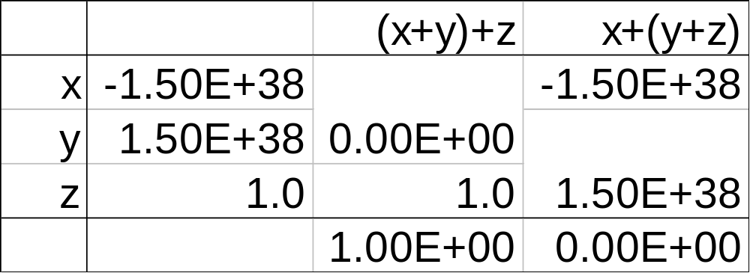
Pitfall: Floating-point addition is not associative
Parallel programs may interleave operations in unexpected orders
  Assumptions of associativity may fail
Need to validate parallel programs under varying degrees of parallelism

Slide 46
Fallacy: Only theoretical mathematicians care about floating-point accuracy
Important for scientific code
  But for everyday consumer use?
    “My bank balance is out by 0.0002¢!” ☹
The Intel Pentium FDIV bug
  The market expects accuracy
  See Colwell, The Pentium Chronicles

Slide 47
Concluding Remarks
ISAs support arithmetic
  Signed and unsigned integers
  Floating-point approximation to reals
Bounded range and precision
  Operations can overflow and underflow
RISC-V ISA
  Core instructions: 17 most frequently used
    SPEC CPU2006 integer and floating-point benchmarks: 76%
  Other instructions: less frequent
§3.10 Concluding Remarks

